Slide 1
Introduction to Software Engineering (SE)

Slide 2
What is Software?
Software is: (1) instructions (computer programs) that when executed provide desired features, function, and performance; (2) data structures that enable the programs to adequately manipulate information and (3) documentation that describes the operation and use of the programs.
Software is developed or engineered, it is not manufactured in the classical sense.

Slide 3
Category of Software
system software
application software
engineering/scientific software
embedded software
product-line software
WebApps (Web applications)
AI software

Slide 4
Legacy Software
Why must it change?
software must be adapted to meet the needs of new computing environments or technology.
software must be enhanced to implement new business requirements.
software must be extended to make it interoperable with other more modern systems or databases.
software must be re-architected to make it viable within a network environment.

Slide 5
Definition – Software Engineering
The IEEE definition: The application of a systematic, disciplined, quantifiable approach to the development, operation, and maintenance of software, that is the application of engineering to software.
Software engineering is the use of sound engineering principles in order to obtain economical software that is reliable and works efficiently on real machines.

Slide 6
Need of SE
Challenge for Software Engineers is to produce high quality software with finite amount of resources & within a predicted schedule
Software engineering is important because it enables us to build complex systems in a timely manner and with high quality

Slide 7
Software Engineering : a few realities
It follows that a concerted effort should be made to understand the problem before a software solution is developed.
It follows that design becomes a pivotal activity
It follows that software should exhibit high quality
It follows that software should be maintainable.

Slide 8
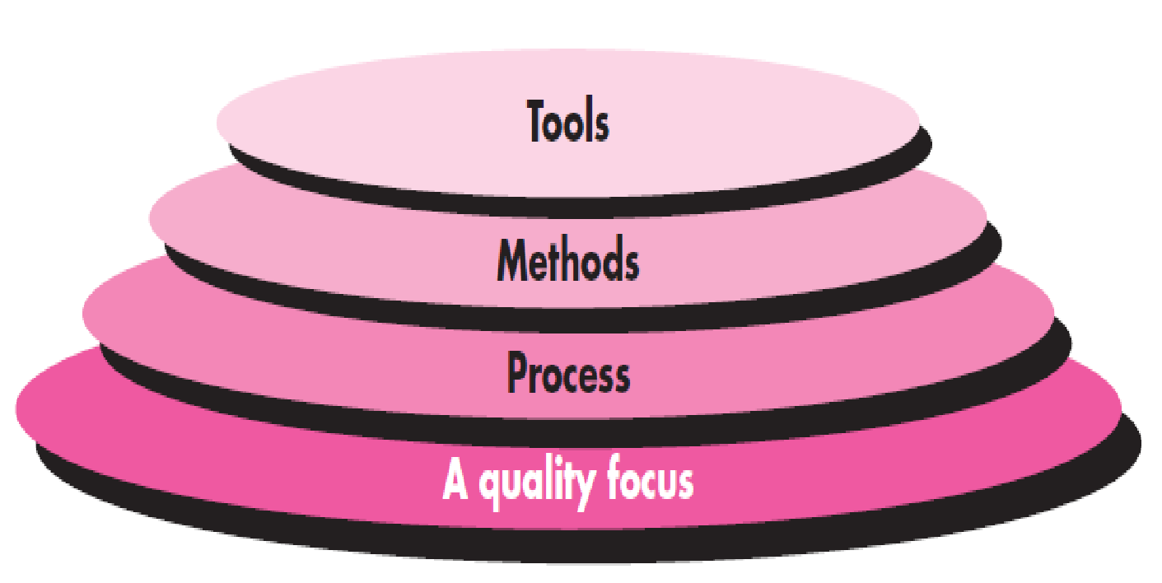
Software Engineering Layers

Slide 9
Process & Software Process
A process is a series of actions or steps taken in order to achieve a particular end.
A software process (also knows as software methodology) is a set of related activities that leads to the production of the software. These activities may involve the development of the software from the scratch, or, modifying an existing system.

Slide 10
What is Practices?
the actual application or use of an idea, belief, or method, as opposed to theories relating to it.
Or
the customary, habitual, or expected procedure or way of doing of something.

Slide 11
The Software Process
A generic process framework for software engineering encompasses five activities:
Communication
Planning
Modeling
Construction
Deployment

Slide 12
Umbrella activities
Software project tracking and control
Risk management
Software quality assurance
Technical reviews
Measurement
Software configuration management
Reusability management
Work product preparation and production

Slide 13
The STQ Approach
STQ stand for Scope, Timeliness and Quality
Scope: Work/ task to be done to have the complete solution
Timeliness: With a certain time line and budget
Quality : End result as per agreed expectation

Slide 14
Requirement
Software has become deeply embedded in virtually every aspect of our lives,
Increase in the number of stakeholders so many voices must be heard.
Each of them has a slightly different idea or view
It follows that a concerted effort should be made to understand the problem before a software solution is developed.

Slide 15
Design
requirements demanded by individuals, businesses, and governments are becoming increasingly complex with each passing year
The complexity of these new computer-based systems and products demands careful attention to the interactions of all system elements.
It follows that design becomes a pivotal activity

Slide 16
Quality : Component
Functionality. The capability to provide functions which meet stated and implied needs when the software is used
Reliability. The capability to maintain a specified level of performance
Usability. The capability to be understood, learned, and used
Efficiency. The capability to provide appropriate performance relative to the amount of resources used
Maintainability. The capability to be modified for purposes of making corrections, improvements, or adaptation
Portability. The capability to be adapted for different specified environments without applying actions or means other than those provided for this purpose in the product

Slide 17
Maintainability
As the perceived value of a specific application grows, the likelihood is that its user base and longevity will also grow
demands for adaptation and enhancement will also grow.
It follows that software should be maintainable

Slide 18
Activity 1
Write down the process to prepare tea.

Slide 19
Software Process
When you build a product or system, it’s important to go through a series of predictable steps—a road map that helps you create a timely, high-quality result.
The road map that you follow is called a ‘software process.’

Slide 20
End of Class
Let’s Talk

Slide 24
One more Suggestion
Now you have become a master student …. So be Mature …
How many times you heard this statement ???

Slide 25

Now you have become a master student …. So be Mature …
All Agree ???
Instead
Become Courageous
Become Sensitive
And most important … Always be a kid @ heart

